Slide 1
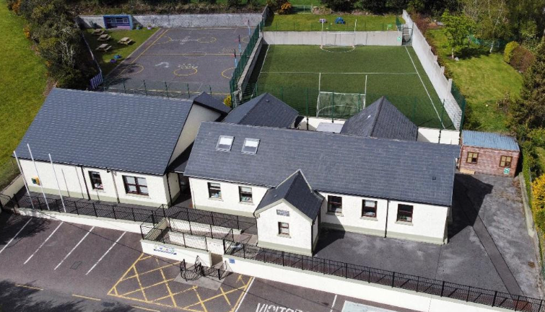
MEETING FOR PARENTS OF OUR NEW JUNIOR INFANTS
WELCOME TO KNOCKANES NATIONAL SCHOOL

Slide 2
INTRODUCTION
Staff
6 Teaching Staff;
3 classroom teachers
Ms Niamh Fenton (J & S Infants)
Ms Maura Amy O Connor (1st, 2nd & 3rd Classes)
Mr Pádraig O Connor (4th, 5th & 6th Classes)
2 Special Education Teachers
Ms Lucy O Sullivan & Ms Mairéad Fogarty
Ms Marie Cronin – Teacher of Special Class for Pupils who are Deaf & Hard of Hearing.
SNA Staff:
Noreen Moynihan
Aileen Doherty
Úna O Connor
Marguerite O Donoghue
School Secretary: Marguerite O Donoghue
School Caretaker: Neil Desmond
Bus Escort: Donal O Donoghue
Enrolment
Current Enrolment = 66
Looking forward to welcoming 15 new Junior Infants in Sept.

Slide 3
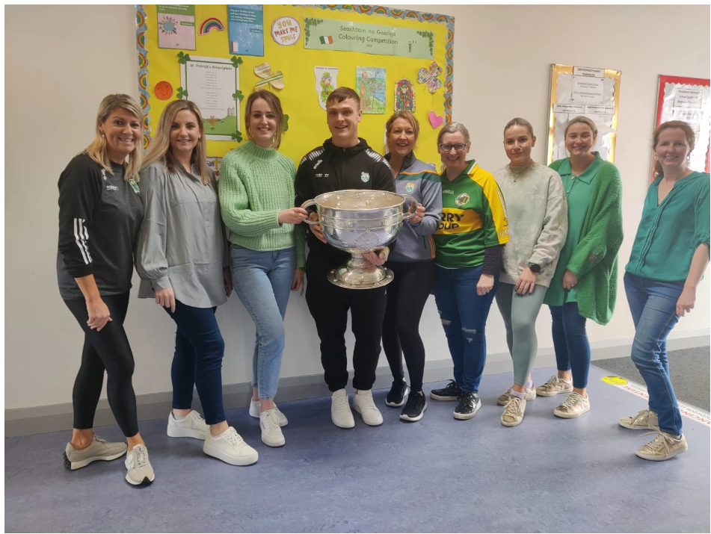
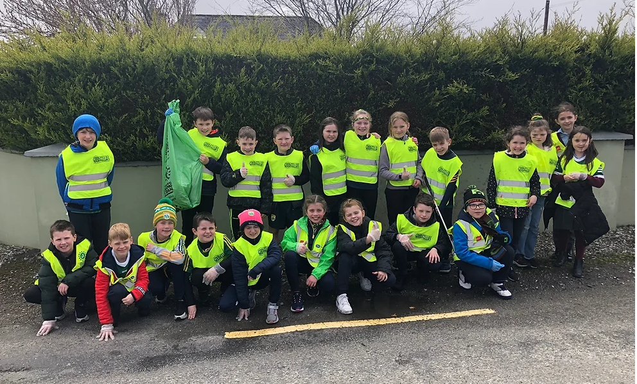
OUR ETHOS
Warm
Homely
Approachable
Supportive
Understanding
Informal
One Family unit
Community centered.
Inclusive

Slide 4
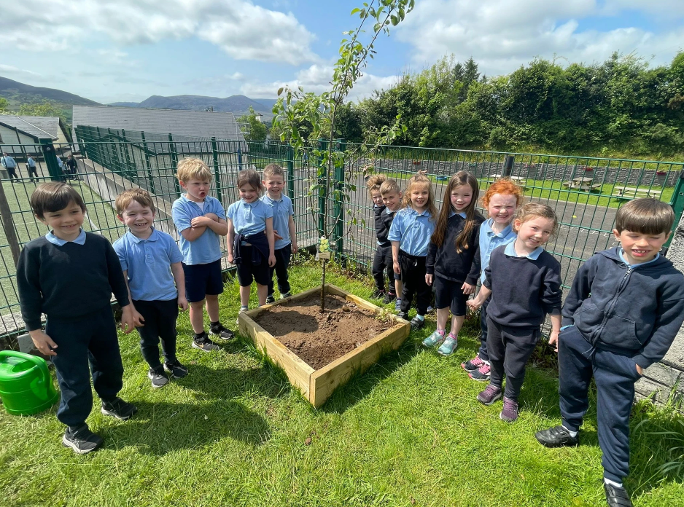
FACILITIES & RESOURCES
Astro Turf Pitch
Yard & Grass Area
Biodiversity Garden
Chromebooks
iPads
Interactive Whiteboards
Comprehensive Literacy Resources & programmes
Sound System in each classroom

Slide 5
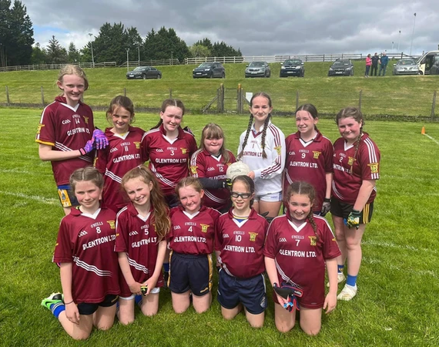
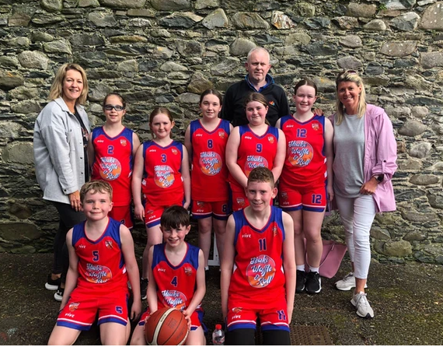
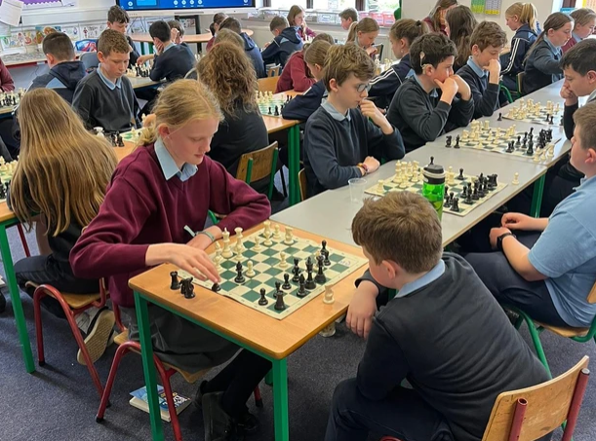
School Activities:
Sports:
Football, Hurling, Camogie
Basketball
Rugby, Golf, Gymnastics
Swimming
Dance
School Tours
Hikes
Nature Walks
STEAM
Seachtain na Gaeilge
Biodiversity Week – Green Schools
Grandparents Day
Local History & Geography tours
Talent Show
Sports Day
Music with Henry
Chess
Student Council
Green School Committee

Slide 6
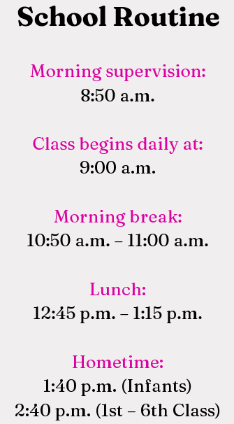
School Routine:
Pupils in Knockanes NS wear tracksuit to school each day.
Promotes & support an active school life.
Burgundy/ Wine Tracksuit & Blue Polo Shirt
Shorts same material and colour as tracksuit
Widely available:
Dunnes, M&S, Walshe Bros.
Comfortable running shoes

Slide 7
ALADDIN
Communication APP
Family Notes
Events
Reminders
End of Year Reports
Notes to & from Class Teachers
Absences & late notes
Permissions
Will be in touch regarding the use of same.

Slide 8
WEBSITE https://www.knockanesns.ie/
Keep an eye on our website for;
Events
Photos
Policies
Family notes
Information
Also check out our Facebook Page.
Instragram ….. Coming SOON!

Slide 9
Board of Management
BOM responsible for the effective operation of the school.
Ratify all policies & appointments to staffing
Oversees Finances
Meet regularly but at least 5 times per year.
BOMs are extremely supportive elements of the school
8 Members
2 Patrons Nominees
2 Staff Nominees
2 Parent Nominees
2 Community Nominees
New BOM to be formed in November 2023

Slide 10
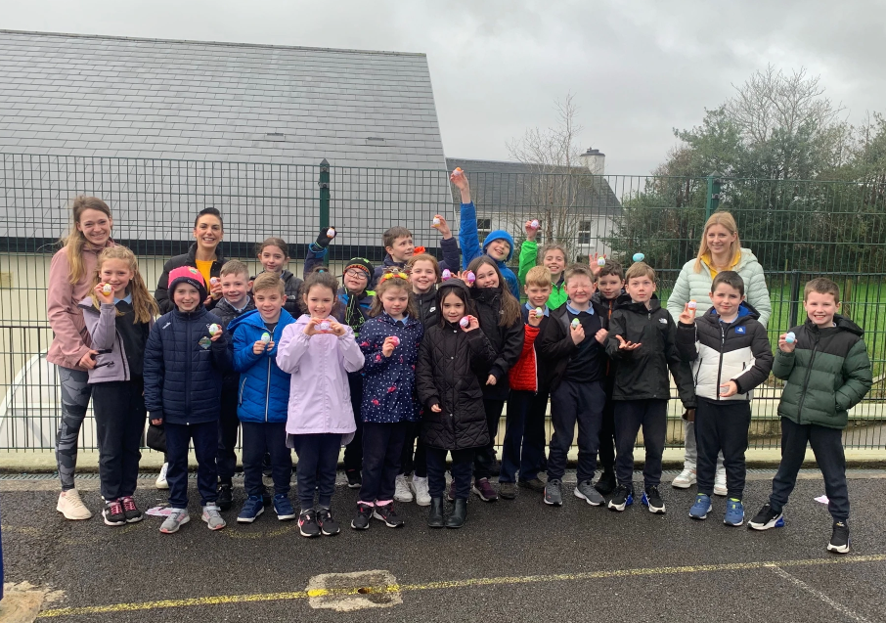
PARENTS ASSOCIATION
Very well supported by our parents
Activities include:
Fundraisers
Maintenance work
In school initiatives & events
Sharing of expertise!
School Masses
Great comradery
Always welcoming of new members
AGM Sept/ Oct

Slide 11
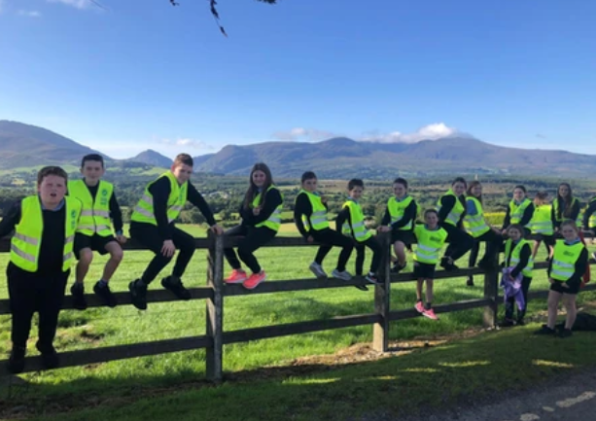
SUPPORT TEACHING
Occasionally, pupils require extra support
Some short interventions – review & adapt
Other more sustained intervention
‘Fluid Groups’
Infant classes regularly receive support from our SET – reinforces class teaching, allows them to work in smaller focus groups
SET – team teaching to support a whole school initiate eg Literacy Programme, Hand Writing, ICT…
Assessment and monitoring part of school life
External supports; NEPS, CAMHS, Occupational Therapy, Speech & Language Therapy etc.

Slide 12
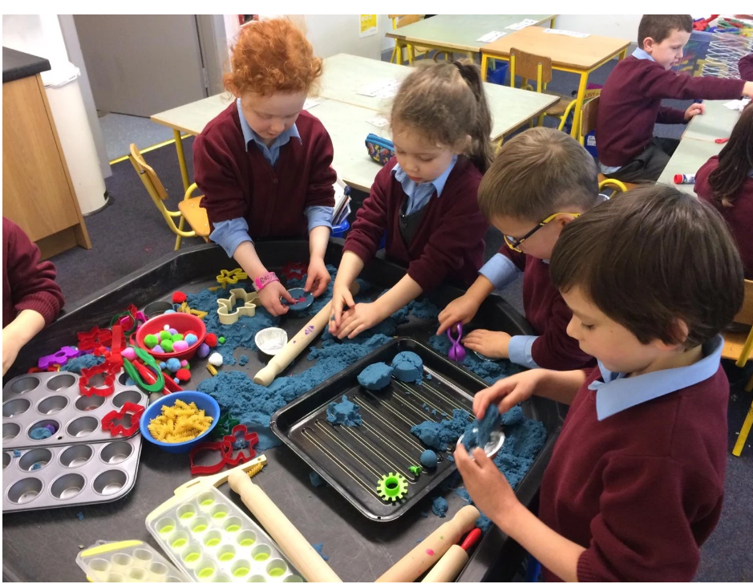
JUNIOR INFANTS
Initially –
Our first job is to settle each child into their new school environment
Every child is an individual.
Nerves are normal!
No rush
Happiness leads to learning.

Slide 13
THINGS YOU NEED TO BEGIN NOW.
a) Allow us to be an excellent school in their eyes. In their heads let them be confident in the knowledge that they are going to a fine school. Would you rather be going to a very good Knockanes School or to hear parents saying I don’t like this or that about it.
b) Pupils need to be able to use the toilet independently.
c) Get them putting on their own coats, matching socks, counting forks to set the table etc.
d) Need to understand rhyme. Recite nursery rhymes. Not old fashioned and we all know them. They can be said in the car, rhyme and memory.
e) Read to your child, everyday at least once a day. (They are entering a world of books)
f) Buy coloured paper, white paper, safety scissors, glue and crayons and have it available to them.
g) Just because you weren’t good at something doesn’t mean they can’t be good at it. Be careful what you say.

Slide 14
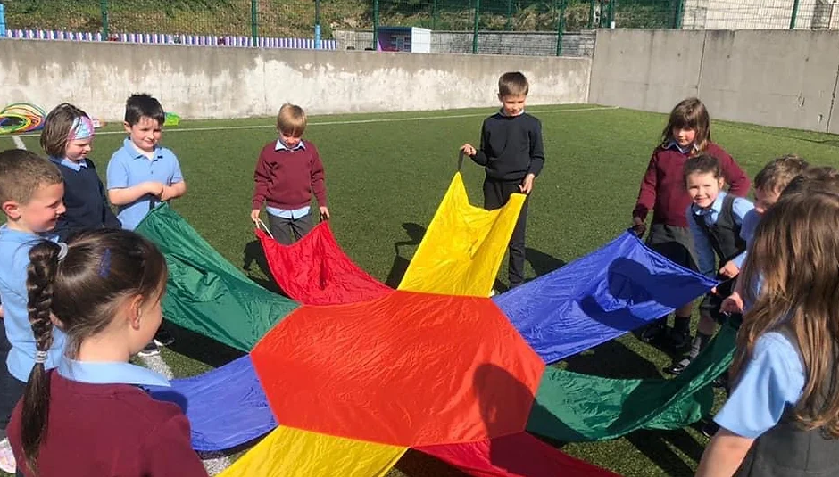
WHEN SCHOOL BEGINS..
Fresh air & exercise is important! If Sunday is wet and they spend the whole day on screens they are not going to be able to work with teacher on Monday..
- School opens & supervision begins – 8:50am – Greeted at front door – yard time – 9:00am
Finish at 12pm for first week (until Wed 6th Sept)
School is enough! Probably no need to do anything too demanding after school for a few weeks/first term as they’ll be exhausted.
- Don’t worry about eating; When they settle they’ll eat.
Presume they had a good day. You will hear it and see it if something is bothering them.

Slide 15
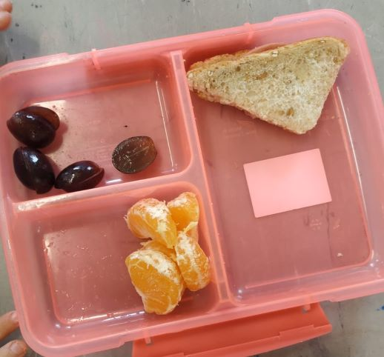
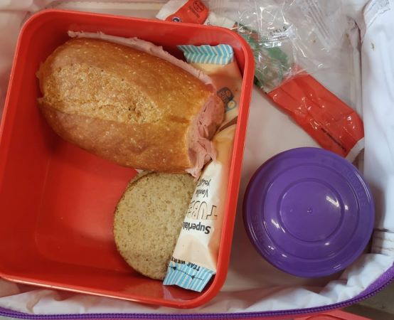
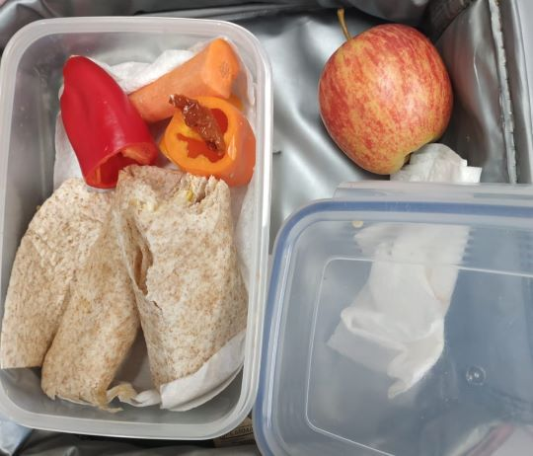
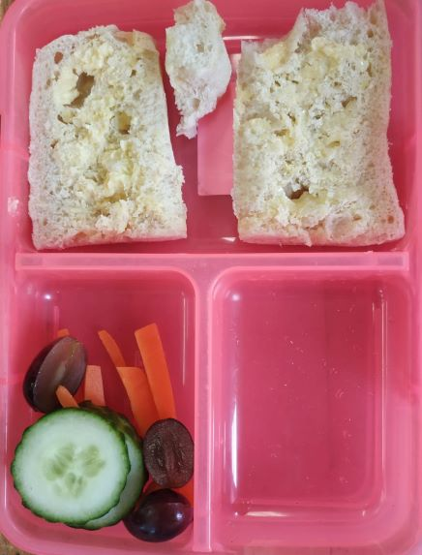
LUNCHES
Good healthy lunches. They don’t need sweet treats e.g. chocolate croissants, yoghurt rice cakes, petit filous.
Fruit, slice of bread, pieces of cheese, meat…..
Water is ideal – fruit juices = more sugar!
(2 breaks from 7th Sept)

Slide 16
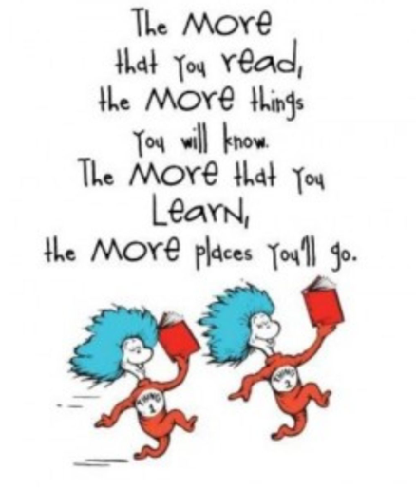
ENGLISH
Homework Meeting in September
with Class teacher to give further detail!
- -Whole School Approach to
-
-Reading
-Rhyme
-Story
- cursive letter formation; get it right from the start even if it doesn’t look like the letter.
-Reading buddies

Slide 17
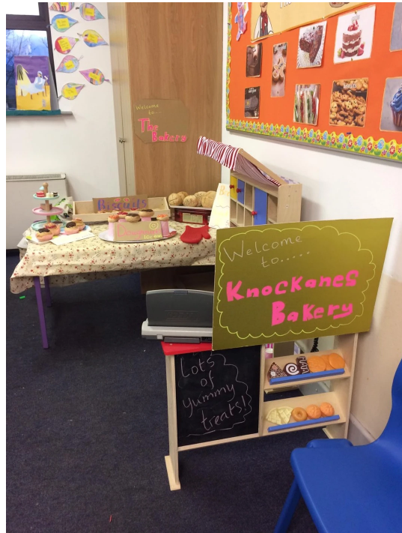
AISTEAR Learning Through Play
Thematic Approach
Imagination
Oral language
Literacy
Numeracy
Drama
Art & Craft
Play
Group work
Turn Taking

Slide 18
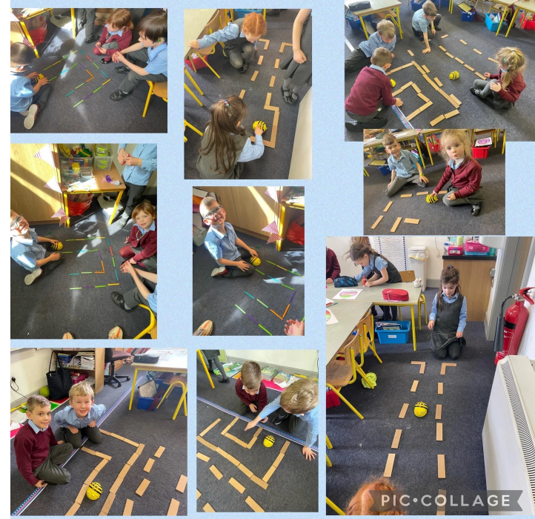
MATHS
Concrete materials.
a. counting…every morning
b. Number 1- 10 - estimation
c. measure….size, weight, length, volume – baking, gardening, etc.
d. time….days, seasons, time of day, o clock time.
e, Adding
f, higher order thinking..5 children in a car, 2 boys so how many girls

Slide 19
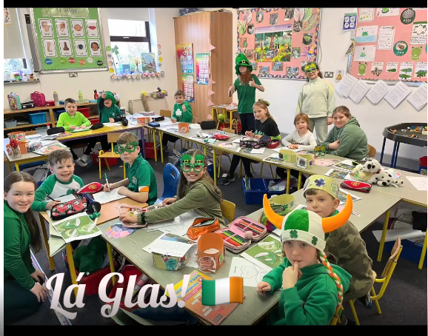
GAEILGE
- Language is easy for them!
Interactive Programme – Caint is Cómhrá
Songs,
poetry,
stories,
dramaí beaga,
Puppets
Frásaí na Seachtaine
Gaeilgóir na Seachtaine

Slide 20
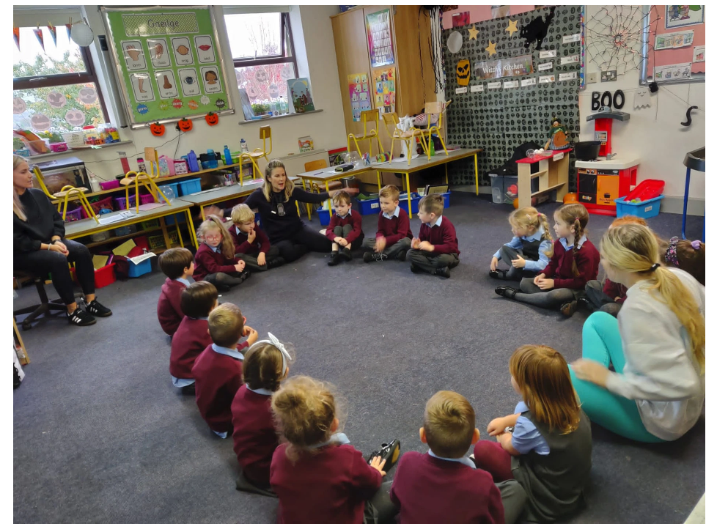
HOMEWORK
Starts small…
Not for new teaching
It is to reinforce what we do at school.
Consistency is key!
Homework Folders
Literacy – NB!
10-20 mins is sufficient!
Homework Club – 1st – 6th Classes
.

Slide 21
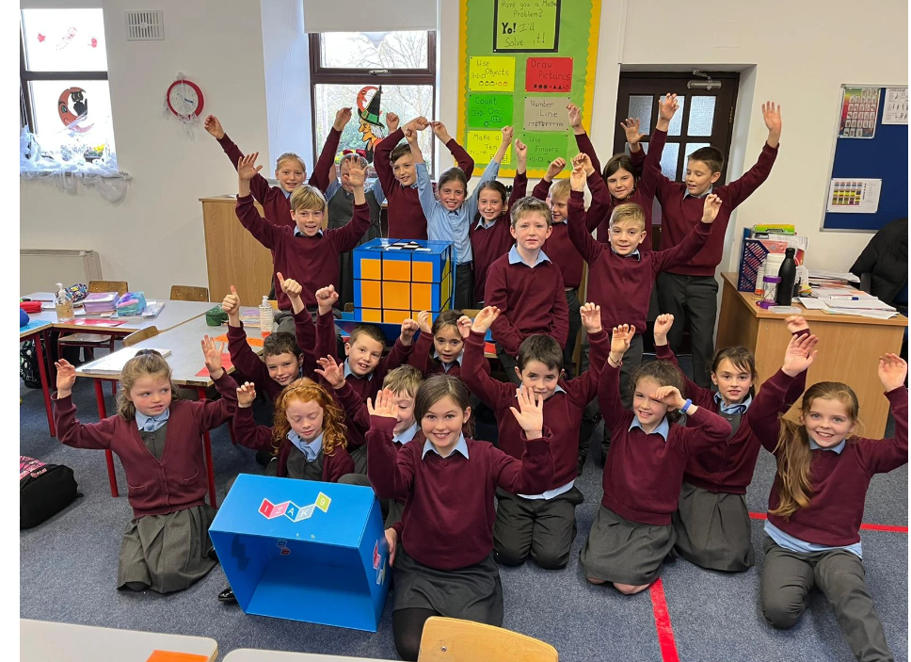
CONFIDENCE
The whole experience is about building confidence. Safe, safe to fail, move out of their comfort zone..
-Feel safe
-Group work
- Change seats
Activities during the year: Football, Gardening, Gymnastics, Nature walks etc….
- Working with ALL staff
- Visitors to our school: Ian McGrigor, Dan the Postman, Mr Cooper, Coaches etc.
Assemblies: Promoting & rewarding positive behavior, celebrating achievements & successes, presenting to our peers – YOU ARE AMAZING!

Slide 22
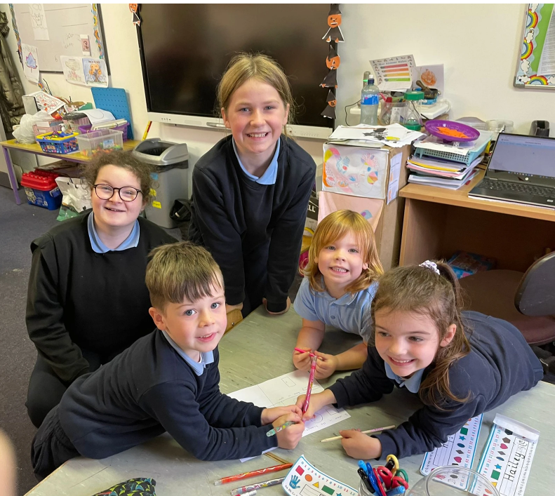
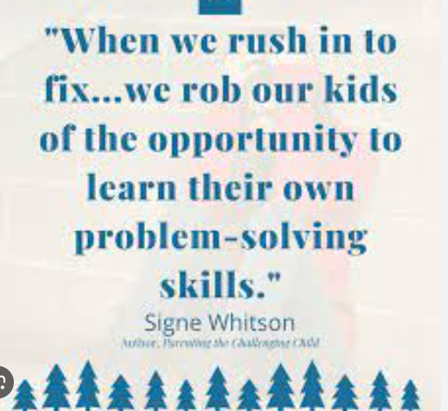
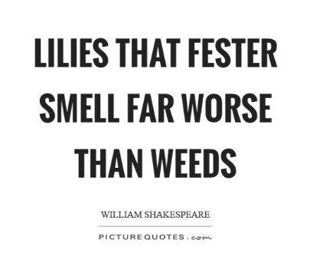
Reminders:
Uniform & Belongings – label
Pencil Case – 1?
Booklist – Free Book Scheme
12pm for first week
Size of bag – no add on?
Lunch, healthy, no sugar/chocolate – allergies?
Let them hear you say how happy they will be at school ☺
If you have a concern....
If we have a concern…
Building resilience is important
Share promptly – easier to solve
After School Fun Club 1:40-2:40pm
Contact: Marguerite
€4 per day

Slide 23
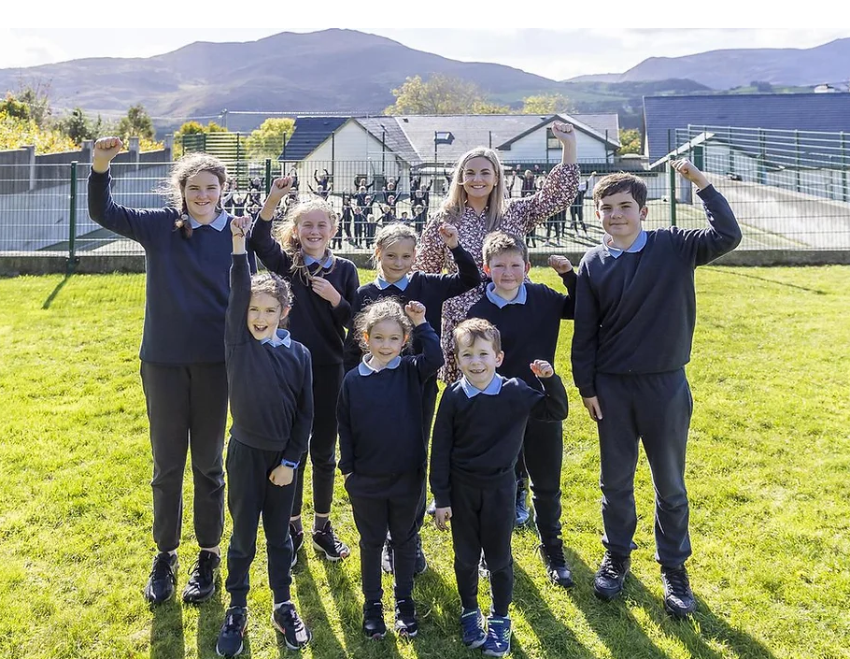
Additional Accommodation Secured
2 new classrooms
New Special Class Room,
1 additional Classroom for Mainstream
Wheels are in motion…. We will get there!

Slide 24
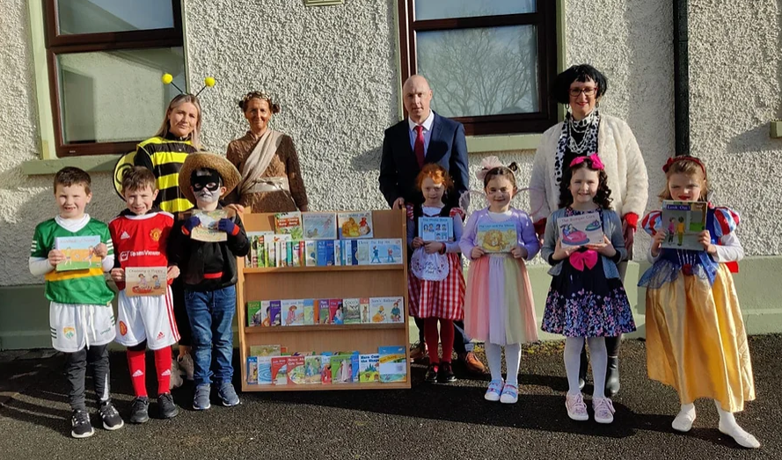
THANK YOU
Thanks for your attendance today.
Any questions?
Email:
knockanesnationalschool@gmail.com
‘Ni neart go chur le chéile’, there is no strength without unity.
We are here to help!
Looking forward to welcoming everyone
On Wednesday 30th August!
​

